Slide 1
OLAP Concepts Part 2
<OLAP Concepts 101 Series>
Anupama Putcha
Notes:
‹#›
Hi, I am Anupama, and Today I will take you through the OLAP concepts Part II module.
The module covers the basics of Data Access and tools used for Data Access .
So let us begin our session with an overview of the same.
The Target Audience is:
Team Rainbow (TRB) associates assigned to DW-BI practice after completion of Induction training
Associates newly joined to DW-BI practice with out prior DWH implementation experience
© 2009 Wipro Ltd – Internal & Restricted
‹#›

Slide 2
Module Overview
On-Line Analytical Processing is a decision support software that allows the user to quickly analyze information that has been summarized into multidimensional views and hierarchies.
There are three main features of OLAP system :
Multidimensional Viewing – OLAP supports multidimensional model which consists of facts and dimensions also called as Star Schema.
Calculation Intensive Capabilities – Due to data is stored in facts and dimensions tables, it enables users to analyze data without much calculations.
Time Series analysis – Enables users to analyze data across time.
This Module will cover the details in three parts:
Part 1 – Importance of BI, DWH Architecture and different reporting types.
Part 2 – Data Access and Analysis, OLAP Introduction and Types
Notes:
‹#›
Online Analytical Processing is an approach to quickly answer multi-dimensional analytical queries.
The typical applications of OLAP are in for sales, marketing, business process management (BPM), budgeting and forecasting, financial reporting and similar areas.
The term OLAP was created as a slight modification of the traditional database term OLTP (Online Transaction Processing).
OLAP Concepts are categorized as:
.Understanding the need for data-warehouse, typical architecture and different ways of business reporting
.Understanding the data access and analysis
.Understanding the OLAP types
These details are covered in two parts. This presentation is part II of the series.

Slide 3
OLAP Objectives – Part Overview
Upon completion of this module you will be able to:
Understand What is Data Access and Analysis
See the limitation of traditional decision making tools.
Know the requirements of Data access tools.
See the various category of Data Access and Analysis.
Appreciate the importance of Data Access
Notes:
‹#›
Upon completion of this Part module you will be able to:
Understand What is Data Access and Analysis
Ascertain the limitation of traditional decision making tools.
Understand the requirements of Data access tools.
Understand the various category of Data Access and Analysis.
Appreciate the importance of Data Access

Slide 4
OLAP Outline
Lesson 1 Data Access & Analysis
Lesson 2 OLAP Introduction
Lesson 3 OLAP Types
Notes:
‹#›
Lesson 1 deals with the need and importance of Data Access and Analysis
Data Analysis is a huge part of Business Intelligence. Business Intelligence programs are designed to collect the past as well as the present data of an organization, whether it is financial, productivity data, customer data, trend data ,or any other data company related data that needs to be modified in order to be clear and easy to follow.
The next step is to thoroughly analyze the data that has been collected. Some companies prefer to use charts and graphs others may use tables. No matter the means in which the data is analyzed it is done in a precise and detail oriented manner. Figuratively speaking, no stone is left unturned.
Modern Business Intelligence systems are designed to analyze and cross analyze large amounts of unstructured data. This can range from production metrics to customer attrition figures. These systems provide historical, current, and predictive views of business operations. The systems house data analysis tools that can be applied to virtually any area of an organization, and present the data in a clear, concise manner.
Lesson 2 talks about Introduction to OLAP
OLAP History
OLAP is not a new concept and has persisted through the decades. As a matter of fact, the origin of OLAP technology can be traced way back in 1962. It was not until 1993 that the term OLAP was coined. It has undergone several stages of evolution whose patterns of progress are relatively intricate to follow through.
It was Kenneth Iverson who first introduced the base foundation of OLAP through his book “A Programming Language”, which defined a mathematical language with processing operators and multidimensional variables.
A new multidimensional product emerged during the year 1970’s, which became a popular OLAP offering, in the form of Express. This was the first multidimensional tool directed to support marketing related demands or application needs. It later on evolved into a hybrid OLAP after its acquisition by Oracle and has thrived for more than 3 decades
The 1980’s period played a significant role in the advancement of the OLAP industry as this triggered the rise of many multidimensional products.
A new end-user analysis tool was becoming a favorite during the latter period of 1980. The spreadsheet market was fast prevailing which compelled some of the vendors to create multidimensional applications that could reside on a spreadsheet environment.
Lesson 3 explains the different types of OLAP and also talks about the benefits of each type.

Slide 5
Data Access and Analysis
Notes:
In Part I of OLAP Concepts we have understood limitations in traditional decision support system, significance and future of business intelligence, and hence let us understand one of the key aspects of DWH & BI Application i.e. Data Access and Analysis
Data Access typically refers to software and activities related to storing, retrieving, or acting on data housed in a database or other repository
Data Analysis has multiple facets and approaches, encompassing diverse techniques under a variety of names, in different business, science, and social science domains. In short data analysis is a process of gathering, modeling, and transforming data with the goal of highlighting useful information, suggesting conclusions, and supporting decision making
In this section we will explain
Importance of Data Access & Analysis
Various Categories of Data Access & Analysis
Information Consumers i.e. Users

Slide 6
Importance
Facilitates easy and controlled access to authorized users
Provides helpful metadata to the users
Lowers operating costs
Encapsulates technical complexity like physical structure of the database from the users
Notes:
Businesses today face challenges like
Large volume of data
User demands of flexible and timely access to information
Extracting value from key business data
Data Access is the ‘last mile’ that enables decision makers to
Reach the database infrastructure
Prompt, reliable data access
Lowers operating costs
Reduces error
Increases productivity.

Slide 7
Categories - 1
Different categories of Data Access ..
Reporting
On-Line Analytical Processing (OLAP)
Data Mining
Web Access
BI
Reporting
Delivery Focused
WEB ACCESS
OLAP
“Heavy
Analytics “
Analytic Focused
Data Mining
Notes:
‹#›
Data access layer categorized in various ways of accessing data resides in data warehouse.
Reporting can be done over the Web or in desktop based environment and may or may not be for business intelligence. Regular operational reporting can be happened just to do a end of the balance check of customer account and a reconciliation with prior day balance and the day’s transaction. This type of report may not provide any business intelligent to help in growth of organization
All OLAP analysis happens over the web because it needs multiple access in more flexible environment to analysis the performance of business. This type of analysis requires ad-hoc intelligences in the report to support. For an example, one Sales senior manager wants to understand the zone wise. Agent wise, insurance policy in last quarter against the sell of policy in the prior quarter. This type of analysis requires more flexibility to check the values against selected dimensions to understand the business
Data mining is a specialty analytical system where we finds for hidden trend or truth of data.
Web access – a common feature of business intelligence tool

Slide 8
Categories - 2
Reporting
A category of data access solution in which the information is presented in the form of reports
Reporting tools are also referred as Query and reporting tools
OLAP
Defined as “Fast Analysis of Multidimensional Information” by the OLAP council
Used interchangeably with ‘Business Intelligence (BI)’
OLAP tools are synonymous with Multidimensional tools or applications
Notes:
‹#›
Online Analytical processing allows the user to quickly analyze information that has been summarized into multidimensional views and hierarchies. Data are organized into a cube structure that can be rotated by the user. The output of an OLAP query is typically displayed in a matrix (or pivot) format. The dimensions form the rows and columns of the matrix; the measures form the values.

Slide 9
Data Access and Analysis - Categories
Data Mining
A process that uses a variety of statistical and artificial intelligence frameworks to discover patterns and relationships in data
Used to make valid predictions in data analysis problems where the exact sequence and nature of queries/questions to be written/asked against the data to make the prediction is not known and the number of variables involved in the analysis is too large to be intuitively handled by structured querying or OLAP tools
Web Access
A category of data access solutions in which information is viewed through a web browser
Notes:
‹#›
In simple words, data mining can be defined the automatic extraction of useful, often previously unknown information from large databases or data sets.
This technique focuses on modeling and knowledge discovery for predictive purposes.

Slide 10
Users
Reporting Solution | OLAP Solution | Data Mining Solution | Web Services Solution
Operating personnel, Standard fixed format reports for power users | Analysts, Decision makers | Decision makers | Operating personnel, Analysts, Decision makers
Notes:
‹#›
This table provides the information about the various categories of BI users and the kind of data access and analytical tools they use.
Reporting is done for both the purposes – operational requirements and as well as business reporting. So different group of users are associated to this area, not necessarily always the senior business executives.
In contrary OLAP analytics and Data mining are required by the analyst and decision makes, who need to dig in to the operational data and identify the meaningful trend and truth of the business

Slide 11
Data Access & Analysis Tools
High Performance
Scalable
Ease of Use
Rich Reporting Features
Encapsulates technical complexity like physical structure of the database from the users
Facilitates easy and controlled access to authorized users
Provides helpful metadata to the users
Provides a variety of features for analyzing the data
Notes:
Data Access & Analysis Tools
High Performance – Enterprise’s today carry voluminous data, however data access tools are expected to provide instant desired results
Scalable – Business users are spread cross departments, business units that may be geographically distant apart and quite possibly speaking different languages, today’s data access & analysis tools are expected to be scalable enough to cover geo’s, languages, currency etc.
Ease of Use – intuitive, consistent interface to all functions of tool
Rich Reporting Features – Slicing and Dicing of Information, Drill-down’s, roll-up’s, drill-through
And the list is never ending
Like for instance
Short learning curve
Tight integration with central metadata repository
Scheduling of reports should be possible

Slide 12
Introduction to OLAP
Notes:
OLAP is defined as ‘Online Analytical Processing’ which is a part of the broader category of Business Intelligence.
There are three main features of OLAP system :
Multidimensional Viewing – OLAP supports multidimensional model which consists of facts and dimensions also called as Star Schema.
Calculation Intensive Capabilities – Since data is stored in facts and dimensions tables ,it enables users to analyze data without much calculations.
Time Series analysis – Enables users to analyze data across time .

Slide 13
OLAP – An Introduction
OLAP – On Line Analytical Processing
On Line – Emphasizes live access to data, not static reporting
Analytical Processing – Ad-hoc quires, drill-down, roll-up, reporting across various dimension
Category of technology that enables users to gain insight into their data in a fast, interactive and easy to use manner
OLAP provides the following 3 features
Multidimensional viewing Capabilities -Browsing and Navigation (Slice and dice)
Calculation Intensive Capabilities
Time Intelligence - Time Series analysis
Notes:
Business is a multidimensional activity and businesses are run on decisions based on multiple dimensions. Businesses track their activities by considering many variables.
To analyze and report on the health of a business and plan future activity, many variable groups or parameters must be tracked on a continuous basis—which is beyond the scope of any number of linked spreadsheets. These variable groups or parameters are called Dimensions in the On-Line Analytical Processing (OLAP) environment.
DatabasesDatabases configured for OLAP use a multidimensional data model, allowing for complex analytical and ad-hoc queries with a rapid execution time. They borrow aspects of navigational databasesDatabases configured for OLAP use a multidimensional data model, allowing for complex analytical and ad-hoc queries with a rapid execution time. They borrow aspects of navigational databases and hierarchical databasesDatabases configured for OLAP use a multidimensional data model, allowing for complex analytical and ad-hoc queries with a rapid execution time. They borrow aspects of navigational databases and hierarchical databases that are faster than relational databasesDatabases configured for OLAP use a multidimensional data model, allowing for complex analytical and ad-hoc queries with a rapid execution time. They borrow aspects of navigational databases and hierarchical databases that are faster than relational databases.[4]
The output of an OLAP query is typically displayed in a matrix (or pivot) format. The dimensions form the rows and columns of the matrix; the measures form the values.
At the core of any OLAP system is the concept of an OLAP cube (also called a multidimensional cube or a hypercube). It consists of numeric facts called measures which are categorized by dimensions.
© 2009 Wipro Ltd – Internal & Restricted
‹#›

Slide 14
Key Objects within OLAP
Key Objects within OLAP
Measures – represents factual data
Example: sales, cost, profit
Types of measures
Stored measures (Example: revenue, expense)
Calculated measures (Example: ratio, averages, profit)
Dimensions – identify and categorize data
Example: product, time, geography, customer
Key Components
Hierarchies – a logical grouping of data
Levels – position in hierarchy
Attributes – descriptive information about dimension
Notes:
There are two key objects in OLAP as explained in previous slide i.e. Measures and Dimensions.
Measures are usually numeric which are stored in Fact Tables. Facts are always surrounded by mostly textual context that's true at the moment the fact is recorded.
Dimensions are the business entities stored in Dimension Tables. There are three key components of a dimension i.e. Hierarchies , Levels and attributes. With the help of Dimension tables user can access hierarchical information of a business entity which helps in Drill down/up.

Slide 15
Distinction between OLTP and OLAP
 | OLTP System | OLAP System
Source of data | Operational data; OLTPs are the original source of the data | Consolidation data; OLAP data comes from the various OLTP databases
Purpose of data | To control and run fundamental business tasks | Decision support
What the data reveals | A snapshot of ongoing business processes | Multi-dimensional views of various kinds of business activities
Inserts and Updates | Short and fast inserts and updates initiated by end users | Periodic long-running batch jobs refresh the data
Queries | Relatively standardized and simple queries returning relatively few records | Often complex queries involving aggregations
Notes:
OLTP systems are application oriented, serve the clerical community, can be updated repeatedly and run repetitively .
These systems are performance sensitive (i.e immediate response is required while performing a transaction),
Accessed a unit at a time (limited number of data elements for a single record)
Transaction driven, while OLAP systems are analysis driven,
Small amount of data is used in a single process in an OLTP system, large amount of data is used in OLAP systems.

Slide 16
Functional Requirements of OLAP
Rich dimensional structuring with hierarchical referencing
Efficient specification of dimensions and dimensional calculations
Separation of structures and representation
Flexibility
Sufficient speed to support ad hoc analysis
Multi-user support
Notes:
OLAP helps in building Ad-hoc Queries, enables users to do Trend Analysis, Drill-up ,Drill Down , Slicing and Dicing.
It enables analysts, managers and executives to gain insight into data through fast, consistent, interactive access to a wide variety of possible views of information that has been transformed from raw data to reflect the real dimensionality of the enterprise as understood by the user.
OLAP is implemented in a multi-user client/server mode and offers consistently rapid response to queries, regardless of database size and complexity.
OLAP helps the user synthesize enterprise information through comparative, personalized viewing, as well as through analysis of historical and projected data in various "what-if" data model scenarios.

Slide 17
OLAP Types
Notes:
MOLAP architecture, is the traditional way of OLAP analysis also called as Multidimensional OLAP. In MOLAP, data is stored in a multidimensional cube. The storage is not in the relational database, but in proprietary formats.
ROLAP architecture provides a multi-dimensional view of the data to the user, but stores the data in the relational database format.
This architecture goes with the logic that relational storage of data can give much higher level of scalability, can absorb as many dimensions etc. as needed, and can provide faster response time due to indexing and other features.
As already told HOLAP technologies attempt to combine the advantages of MOLAP and ROLAP. For summary-type information, HOLAP leverages cube technology for faster performance.
When detail information is needed, HOLAP can "drill through" from the cube into the underlying relational data.
DOLAP is a term used to denote single-tier, desktop-based business intelligence software.
DOLAP is often contrasted with MOLAP and ROLAP business intelligence tools.
Web OLAP is the operation of an OLAP tool from a Web browser; a solution that provides a merging of two very dynamic technologies: the World Wide Web and OLAP tools.
‹#›

Slide 18

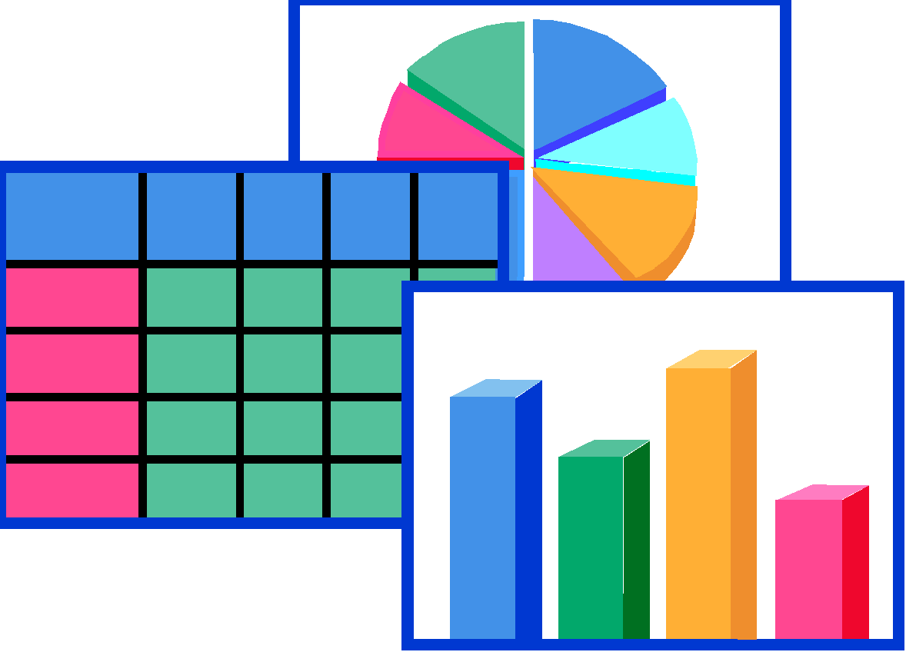


MOLAP – Multidimensional OLAP
Data is stored in multidimensional cubes
MDDB technology is proprietary.
Compilation intensive architecture.
Load involves series of aggregations across orthogonal dimensions
Good to access pre-aggregated data
MDDB Engine
MDDB Engine
Decision Support Client
Database Layer
Application Logic Layer
Presentation Layer
Notes:
‹#›
As you already know that MOLAP is the traditional mode of OLAP analysis in which data is stored in form of multidimensional cubes. Users see their data organized in Cubes with Dimensions and Facts.
A multidimensional database, or MDDB, is a form of database where data is stored in cells and position of each cell is defined by number of dimensions. Each cell represents the Business Event and value of dimension shows when and where this event happened.
You can also understand this as a specialized storage facility that allows data to be pulled from a data warehouse or other data sources in a matrix-like format. The way the storage happens, it reduces the need for database space for small to medium number of dimensions, and can store data more efficiently compared to a relational database The MDDB enables users to quickly retrieve multiple levels of presummarized data through a multidimensional view
There are MOLAP tools like Hyperion Essbase, Cognos, Oracle OLAP, etc available in Market.
Advantages
Intuitive
Performance advantages
Ease of navigation
Little Performance Tuning required
Disadvantages
Proprietary
No standard storage techniques
Aggregate explosion problem
Limited to 50-100 GB of calculated data

Slide 19





ROLAP
Support for large databases with good performance
Excellent platform portability
Good exploitation of hardware advances such as parallel processing
Codd rules however are not concerned about storage, but about functionality only
Data Warehouse
ROLAP Engine
Decision Support Client
Database Layer
Application Logic Layer
Presentation Layer
Notes:
‹#›
As you already know, ROLAP stands for Relational OLAP, Where users see their data organized in cubes with dimensions.
Since the data is stored in relational databases, this model gives the appearance of traditional OLAP’ s slicing and dicing functionality.
This is achieved by thorough use of any SQL reporting tool to extract or ‘query’ data directly from the data warehouse.
Advantages of this model is, that it can handle a large amount of data and can leverage all the functionalities of the Relational Database.
Further we will be seeing more Advantages and Disadvantages of ROLAP
Advantages
Robust security
Multi-user concurrent access (e.g. read-write with locking)
Widely recognized standards
Openness to multiple tools
Based on familiar, proven and scalable technology
Extraction & Replication
Parallelization
Query Optimization
Advanced Indexing techniques
Disadvantages
Computation Intensive queries are slow.
Additional layer of OLAP engine
Non intuitive
As you can see here, ROLAP is depicted as three-tier architecture in which the Database Layer and the Application Logic Layer are separated and the data is stored in relational databases rather than in the multidimensional databases of MOLAP. However, the model presents data to the users, in the form of Multidimensional Cubes.

Slide 20
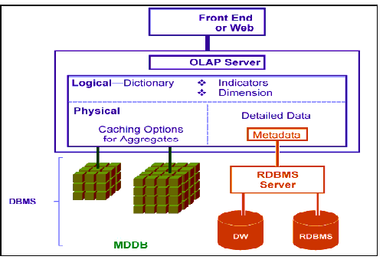
HOLAP - Hybrid OLAP
Hybrid approach seeks to provide best of both worlds - MOLAP and ROLAP
Create MDB structures for fast analytical needs
Create mappings to RDBMS for larger data volumes
The engine hides these mappings/ structures from the end user
Notes:
‹#›
As you know HOLAP stands for Hybrid OLAP, it is a combination of both MOLAP and ROLAP.
HOLAP technology tries to combine the strengths of the above two models. For summary type information HOLAP leverages cube technology and for drilling down into details it uses the ROLAP model.
HOLAP systems stores larger quantities of detailed data in the relational tables while the aggregations are stored in the pre-calculated cubes.
HOLAP users can choose to store the results of queries to the MDDB to save the effort of looking for the same data over and over which saves time. Although this technique - called "materializing cells" - improves performance, it takes a toll on storage. The user has to strike a balance between performance and storage demand to get the most out of HOLAP. Nevertheless, because it offers the best features of both OLAP and ROLAP, HOLAP is increasingly preferred.
Let us see some of the advantages and disadvantages.
Hybrid OLAP Advantages are
High Performance due to MDDB structures
Integration with data maintained in RDBMS
Leverages RDBMS engine and administration skills
Support for large volumes of data by Relational Mappings
There are few disadvantages also, which are associated with Hybrid Model
Managing large number of data structures
Complex Architecture
Expensive

Slide 21
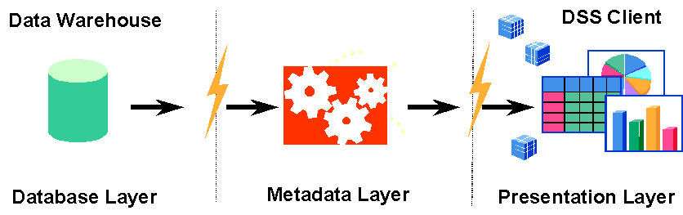
DOLAP
Desktop OLAP tools work by extracting RDBMS data into local (or server) MD cubes
User queries are limited to the predefined dimensions in the hypercube
Do not provide shared environment
Do not provide read/write capabilities
Low cost tools
Notes:
‹#›
DOLAP are Desktop tools, dynamically create a micro cube on either the client PC or, in a web deployment, on a midtier application server.
To create the micro cube, users launch a SQL query using a business view of the data warehouse. The DOLAP tool then sends results back to the desktop and formats it into a cube.
The micro cube format allows users to perform certain functions such as drill-down that historically were only available with MOLAP cubes. It also allows users to issue complex SQL statements, combining data from different fact tables or even spreadsheets, yet presenting the users with one seamless document.
The main benefit of this approach over MOLAP is flexibility; users do not have to define their information requirements ahead of time in a precise way as with MOLAP.
Also, a relational database can store more data than MOLAP cubes, giving users freedom to analyze larger data sets. The downside is slower response times and limited multidimensional calculations. Examples of DOLAP tools are Business Objects and Brio.
Lets have a feel of, how the DOLAP Architecture looks like
As you can see here DOLAP is quite similar to what we have seen in case of ROLAP.
Here we three tier Architecture as Database Layer, Metadata Layer and Presentation Layer.
At Database Layer, the data is stored in relational databases. When data moves from Database Layer to Metadata Layer, the data is presented in form of Micro Cube, which is generated dynamically when User issues any query from front-end with the help of Meta-data. Meta-data is also stored in relational database.
At Presentation Layer users gets a feeling that they are accessing the data from a Cube. Users can issue many complex queries and perform various OLAP functions like Drill, Slice and Dice, Graphical representation of data etc.

Slide 22
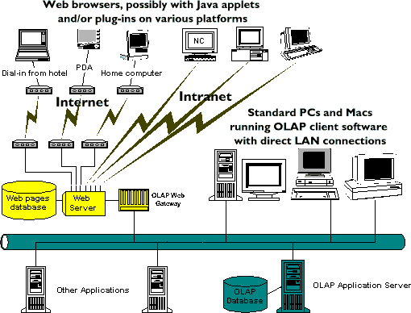
Web OLAP
Most OLAP products can now be deployed to Web browsers
Approaches used
Static Web publishing - The reports are generated in the form of HTML documents
Using a Web OLAP Server - Simple scripts allow users to perform basic manipulations like dimension rotations, drill downs and dimension member selections
Notes:
‹#›
Web OLAP (WOLAP) is the operation of an OLAP tool from a Web browser; a solution that provides a merging of two very dynamic technologies: the World Wide Web and OLAP tools .
A great deal of the growth and interest in data warehousing is due in part to the increased richness, power and flexibility of the current set of OLAP tools. And the explosion of the World Wide Web is due partly to the ease-of-use, fast development and zero deployment effort provided by the Hyper Text Markup Language (HTML) Web browsers. It is just natural that these two technologies would merge.
Lets see how WOLAP Looks Like
Web OLAP architecture is also referred to as a three-tiered architecture.
The Web architecture contains three components:
the client ( Web browser),
the middleware
and the database server.

Slide 23
Quiz
Notes:
‹#›
© 2009 Wipro Ltd – Internal & Restricted
‹#›

Slide 24
Question 1
1. An Operational Data Store is <fill in the blanks> collection of data in support of an organization's need for up-to-the-second, operational, integrated, collective information.“ Which one is the in-correct option ?
integrated
non-volatile
current-valued
detailed-only
Answer: B
Notes:
‹#›
© 2009 Wipro Ltd – Internal & Restricted
‹#›

Slide 25
Question 2
2. The process of data analysis includes:
Gathering, modeling, and transforming data.
highlighting useful information.
suggesting conclusions, support decision making
All of the above.
Answer: D
Notes:
‹#›
© 2009 Wipro Ltd – Internal & Restricted
‹#›

Slide 26
Question 3
3. Which are the different categories of data access techniques that are mainly Analytic Focused?
OLAP
Reporting
Data Mining
A and C
Answer: D
Notes:
‹#›
© 2009 Wipro Ltd – Internal & Restricted
‹#›

Slide 27
Question 4
4. Data Mining Solution is used mostly by:
Analysts
Power users
Decision makers
Operating personnel
Answer: C
Notes:
‹#›
© 2009 Wipro Ltd – Internal & Restricted
‹#›

Slide 28
Question 5
5. What are the key objects in OLAP ?
HOLAP and DOLAP
Measures and Dimensions
ROLAP and MOLAP
Slice and Dice
Answer: B
Notes:
© 2009 Wipro Ltd – Internal & Restricted
‹#›

Slide 29
Question 6
6. What are the different types of OLAP
ROLAP,HOLAP
ROLAP,HOLAP,OLAP
ROLAP,HOLAP,MOLAP and DOLAP
MOLAP,ROLAP
Answer: C
Notes:
© 2009 Wipro Ltd – Internal & Restricted
‹#›

Slide 30
References
Notes:
‹#›
© 2009 Wipro Ltd – Internal & Restricted
‹#›

Slide 31
References
Publications
Courses
URL’s
Training Programs
For further reading, you can visit SAP
Library:
http://help.sap.com/saphelp_46c/helpdata/en/77/bff8ab4a2911d182b80000e829fbfe/frameset.htm>

Slide 32
Thank You
Anupama Putcha
Senior Software Engineer
anupama.putcha@wipro.com

